Slide 1
Objectives
Understand the meaning of high-level and low-level languages
Explain the advantages and disadvantages of each type
Understand that assembly language is a form of low-level language
Describe the operation of compilers and interpreters
Explain the advantages and disadvantages of compilers and interpreters

Slide 2
Questions
A new compact computer has been created for use in conference centres to control presentation screens.
(a) The compact computer contains a bootloader. Explain the role of the bootloader on the computer. [2]
The bootloader is firmware / contained on (flash) ROM (1) which contains the instructions/programs to start the computer (1) and gives the location of the boot sector on the hard drive / hard disk / secondary storage (1).

Slide 3
Questions
(b) The compact computer contains both an operating system and presentation software.
When a presentation is running, the user may make a key press to advance the presentation.
Describe the role and operation of interrupts in this situation.
[3]
When the key is pressed, it generates an interrupt (1).
This is a signal that is sent to the CPU and causes it to pause the current program it is working on (1).
The CPU then handles the interrupt by running the interrupt service routine (ISR) (1).
Once the ISR has completed, the operating system decides which program will now have time on the CPU (1).
When the presentation runs on the CPU, it will advance to the next slide (1).

Slide 4
Questions
In addition to hardware interrupts such as a keyboard press, software interrupts may also occur.
Give two examples of a software interrupt. [2]
If a program tries to divide by zero. (1) If a program tries to access a RAM location that is used by another program / segmentation fault / page fault. (1)

Slide 5
Questions
Sometimes, in the middle of a presentation, the computer freezes and needs to be restarted. A customer support assistant says that the firmware needs to be updated. Describe how updating the firmware may fix the problem.
[3]
The firmware contains low level programs such as the BIOS / Basic Input Output System (1).
If the ROM is a flash ROM, it can be re-flashed / written over with a new version of the BIOS/programs (1).
If there was an error in the original programs, a newer version may fix this (1).
The presentation software makes calls to the operating system, which in turn makes calls to the firmware. Updating the firmware therefore may fix the issue being experienced (1).

Slide 6

Starter
Programs are stored in files
When a program is run, it is first loaded into RAM
If you looked inside the program file rather than running it, what would it contain?

Slide 7
Starter
Program files (executable files) contain machine code
This is the instructions and data that are executed by the CPU
If you view a program file, it will only contain binary
All instructions and data will be stored as binary
When a file is run, the binary data is loaded into RAM and the run by the CPU
0101101101100100
1001111100110010
1100111001110101
0010100010010001
1100101101100111
1110101101010111
1111001010111001
1111011010100111
0110101001000011
101101010 0101001

Slide 8
Machine code and high level code
Computers represent everything in binary, whether it is text, numbers, sound, graphics or instructions
Program instructions, once converted to binary, are known as machine code
Instructions written in a language such as Python, Delphi or Java are known as high level code
Work with a partner to make a list of other high level languages

Slide 9
High-level languages
The high-level languages given were:
Python, Delphi, Java
Some suggestions of other high-level languages are:
JavaScript, C#, Visual Basic, PHP, Pascal, C, C++
Other languages:
HTML is a markup language and not thought of as a programming language as it doesn’t have processing features such as branching with IF statements
SQL is a specific programming language for databases

Slide 10
High level code
Typical instructions in high level code read in a similar way to English and Maths
High-level code is easier to read and write than machine code or low-level languages
For example:
input(Mark1, Mark2, Mark3)
Total = Mark1 + Mark2 + Mark3
print("Total Mark =", Total)

Slide 11

Machine code instructions
A typical machine code instruction looks like this:
0 0 1 0 1 1 0 0 0 1 1 0 1 0 1 1
This makes it very difficult for people to understand as a full program would appear as follows:
0010011001000111 1100100010010110 1100101101000010 1011001001011011 1110100010000011 1110111011101110 0010111111000011 1011001000110010

Slide 12
Machine code
Each different type of processor has its own set of machine code instructions
A typical machine code instruction in a simple processor might occupy two bytes:
The opcode is the instruction to be processed, e.g. ADD, SUBTRACT, LOAD, STORE
The operand is either a value to be operated on or the address of the value to be operated on
Opcode | Register | Operand
0 0 1 0 0 0 | 1 0 | 0 0 0 1 0 0 0 0

Slide 13
Machine code
How many different opcodes are possible in an instruction set with a 6-bit opcode?
What is the largest operand that can be stored in 8 bits?
The processor carries out operations on values that are stored in registers
How many registers does this processor have?
Opcode | Register | Operand
0 0 1 0 0 0 | 1 0 | 0 0 0 1 0 0 0 0

Slide 14
Machine code
How many different opcodes are possible in an instruction set with a 6-bit opcode?
6 bits allow up to 64 different opcodes
What is the largest operand that can be stored in 8 bits?
255 (values from 0 to 255 may be stored in the operand)
How many registers does this processor have?
There are two bits for the register, so up to four registers could be available on the processor
Opcode | Register | Operand
0 0 1 0 0 0 | 1 0 | 0 0 0 1 0 0 0 0

Slide 15
Machine code
Machine code is sometimes called a ‘first generation language’
In the early days of computers, the binary itself was entered through a set of switches on the computer
The ‘second generation’ of programming languages was assembly code, which used mnemonics to represent each opcode, and a denary number or identifier for the operand
Opcode | Register | Operand
0 0 1 0 0 0 | 1 0 | 0 0 0 1 0 0 0 0
Mnemonic | Register | Operand
ADD | ACC | 16
Machine code
Assembly language

Slide 16
Assembly code
An assembly language program looks something like this:
MOV A [17] ;Move contents of memory address 17 into Register A
MOV B [18] ;Move contents of memory address 18 to Register B
ADD A B ;Add Register A and Register B and store in Register A
MOV [19] A ;Store contents of Register A in location 19
Compare this with a high-level language statement:
Total = Mark1 + Mark2

Slide 17
The instruction set
Processors vary in the number and type of instructions they can process
They cannot deal with complex statements like WHILE, IF..THEN..ELSE, etc.
Only very simple instructions are available in assembly languages such as:
ADD A B Add A and B and store in A HLT Halt (stop) the program INC A Increment A (add 1 to A) MOV A B Move the number in A to B JMP [mem] Jump to a different part of the program

Slide 18
The assembler
The computer cannot process assembly language instructions directly as it only processes binary machine code
The assembler is a program which translates assembly code into machine language
This is a relatively simple process as in general, one assembly code statement translates into one machine code instruction
MOV A [17] MOV B [18] ADD A B MOV [19] A
0010011001000111
1100100010010110
1100101101000010
1011001001011011
Assembler
Assembly code
Machine code

Slide 19
Worksheet 4
Complete Task 1 on Worksheet 4

Slide 20
High level languages
High level languages have complex statements and program structures which makes them harder to translate into machine code
if errorCode:
print("You have made an error")
NumErrors = NumErrors + 1
Each statement in a high level language represents several machine code statements

Slide 21
Compiler
A compiler is a program which translates a high level language program (the source code) into machine code
The compiler produces an executable file which means the file can be executed (run)
The machine code created by a compiler is also known as object code
If the compiler encounters a syntax error, it cannot translate the statement so no object code is produced
It provides an error report for all errors that are detected in the code

Slide 22
Compilation process
The compiler translates the entire program at once
It produces an executable file which can be run
This is the file that is usually distributed to the customer
The compiled file will be created for a specific computer architecture and operating system
1110100010000011
1110111011101110
0010111111000011
1011001000110010
0010101011100001
if errorCode: print("Error") NumErrors = NumErrors + 1
Compiler
High-level language
Executable file

Slide 23
Interpreter
An interpreter is a type of program which translates a high level language program into machine code
It translates a line and then, if it has no syntax errors, executes it
It continues like this, translating and executing the code line-by-line
If a syntax error is encountered, it displays an error message and stops executing the program

Slide 24
Compiler or interpreter?
Which should you use?
Interpreter | Compiler
Slower execution as every line is translated before it is executed | Fast execution as the whole program is already ready to execute
A user has to have the interpreter on their computer in order to run the program | The program runs on the computer without the need for an interpreter or compiler as it is already an executable file
A user who has purchased your program can make changes and see how it works | A user who has purchased your program cannot see the source code
An interpreter is faster when developing a program as there is no need to compile the whole program | A compiler is used to translate the final program. This may take some time if carried out during development

Slide 25
Worksheet 4
Complete Task 2 on Worksheet 4

Slide 26

Why use assembly code?
Assembly code is more difficult to learn, write and read than a high level language
Assembly code is also harder to debug and the code will be written for a specific computer architecture
Why do some programs still get written in assembly code?

Slide 27
Advantages of assembly
Assembly code allows the direct manipulation of hardware
Device drivers need to control specific parts of hardware so are usually written in assembly
Other common uses for assembly are the bootstrap stored in ROM, control programs in embedded systems such as a dishwasher, washing machine or car
As the programmer has complete control of the hardware when they use assembly, they are able to make key parts of programs more efficient in processing speed and the use of memory

Slide 28
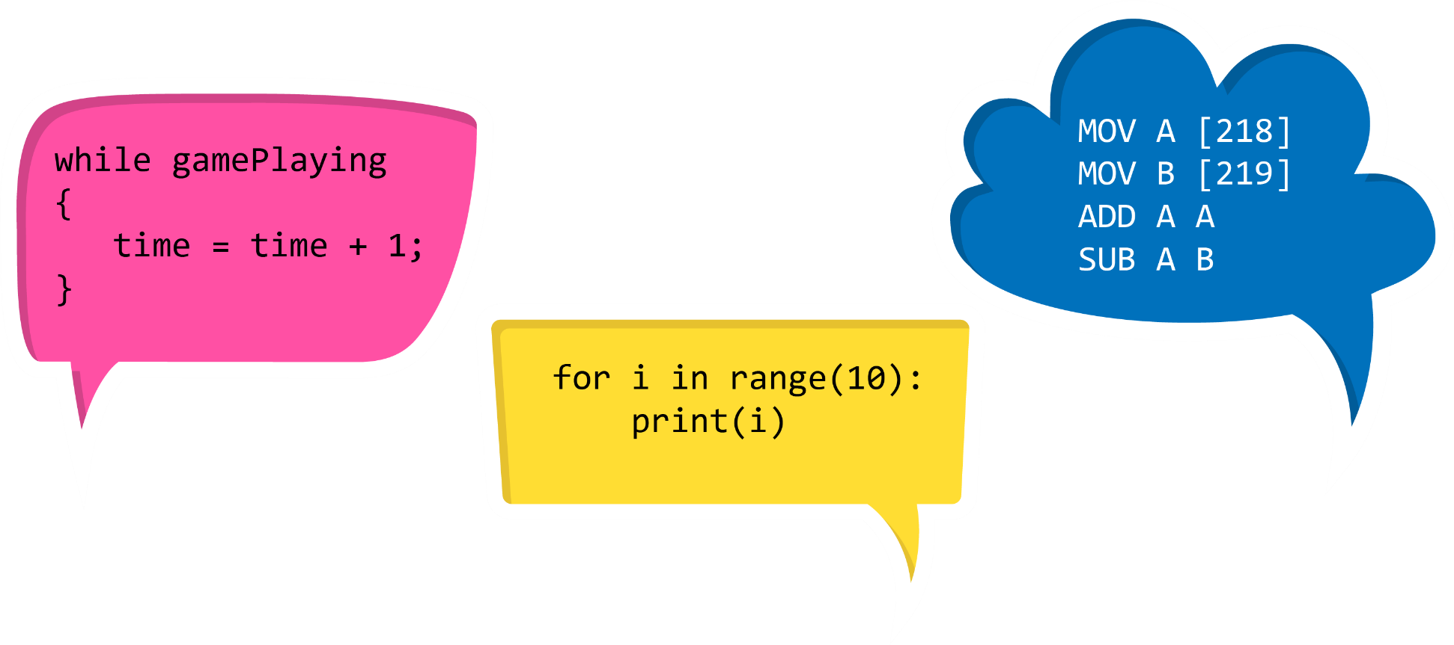
Plenary
Programming code may be assembled, interpreted or compiled
Work with a partner to list the advantages and disadvantages of each type of translation

Slide 29
Plenary
 | Assemble | Compile | Interpreter
Advantages | Direct manipulation of hardware such as needed in device drivers; Used to make efficient code | Easier for programmers to understand as it’s a high-level language; Code only needs to be compiled once; The user doesn’t need an interpreter | Easier for programmers to understand as it’s a high-level language; Machine independent code can be created
Disadvantages | Difficult for people to understand, learn, read and write | The compiled code will only work on a particular platform / CPU architecture meaning it isn’t machine independent | Slower than compiled code as the translation occurs line by line every time the program is run

